Slide 1
Capstone
Trupert Ortlieb
tortlieb@udel.edu

Slide 2
Agenda
Top and Bottom 3 Branches – Revenue and Profit
Top 3 States by Profit and Revenue – Target Texas
Census Gov City Population Growth
Strategies

Slide 3
Lariat Branches Profit and Revenue

Slide 4
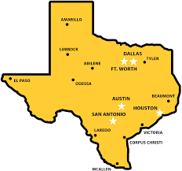
State Revenue and Profit
Target Cities within Texas
Fort Worth, Texas
El Paso, Texas

Slide 5
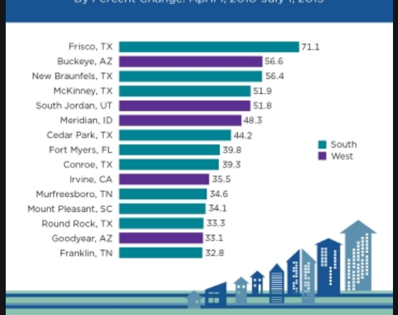
2010-2019 Fastest Growing Cities (%)

Slide 6
Vehicles Information

Slide 7
Strategies
1) Increase the top 3 profitable vehicle by 10%
2) Cut the worst performing branch (Las Vegas, NV) and move to TX

Slide 8
Recommendation

Slide 9
Questions?

